Slide 1
Computer vision project
Parsa Sharifi
Mohammad Javad Maheronnaghsh
Amir Mohammad Fakhimi
Prof. Kasaei

Slide 2
Timeline
Inro
Project1
Project2
Project3
Project4

Slide 3

Computer vision projects
Object Detection
Segmentation
Contrastive learning

Slide 4
Timeline
Inro
Project1
Project2
Project3
Project4

Slide 5
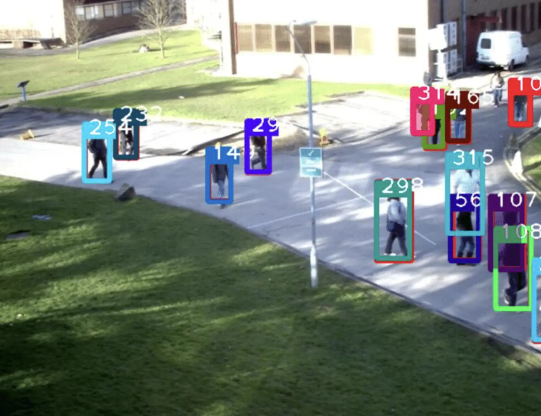
Introduction
Deep Learning Models
(CNNs)(RNNs)(LSTMs)
GANs
(SiamGAN)(TecoGAN)
Transformer-Based Models
(TransTrack)
Hybrid Models
One-Shot Learning Models
GNNs
(GNNT)
Reinforcement Learning

Slide 6
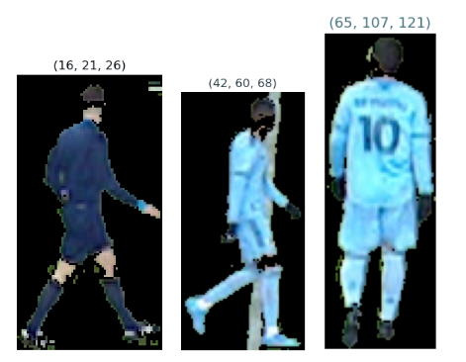
ultralytics Tool
Yolov8
Segmentation & Grass Mask

Slide 7
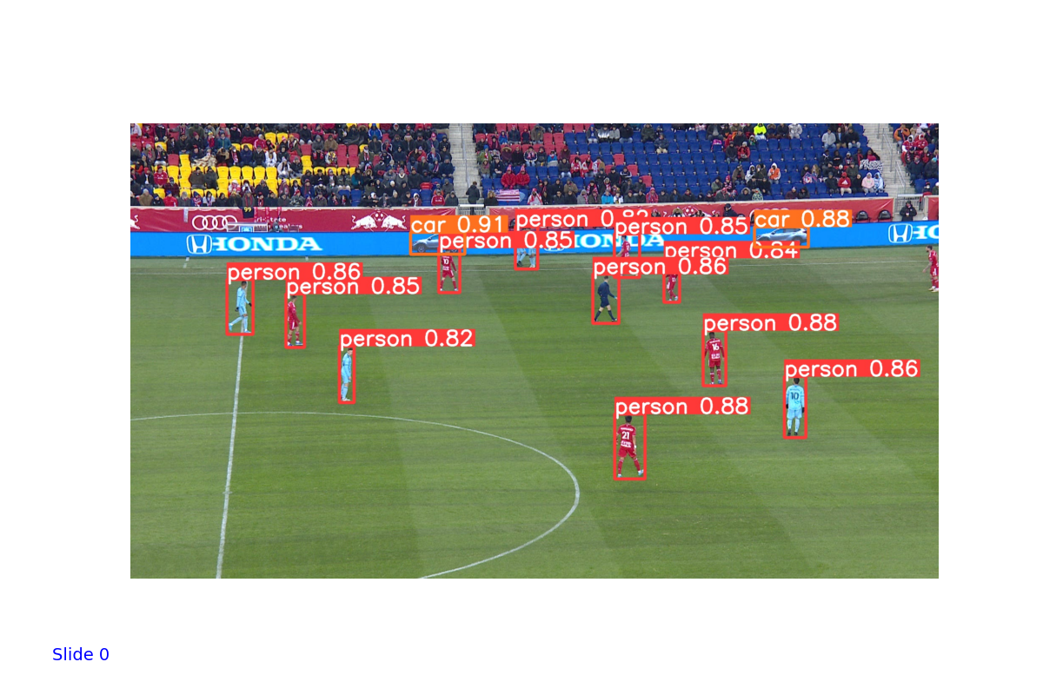
Level of Confidence
Object Detection and Tracking

Slide 8
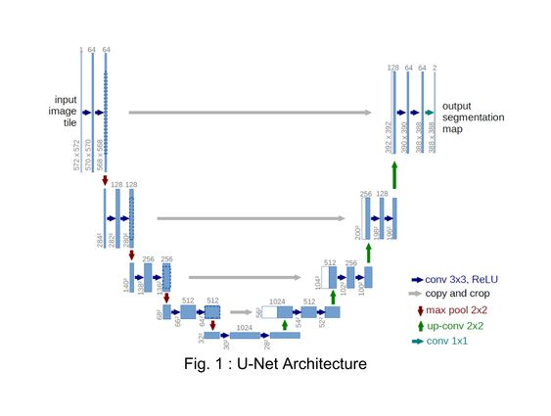
U-Net
U-Net & U2-Net
Segmentation

Slide 9
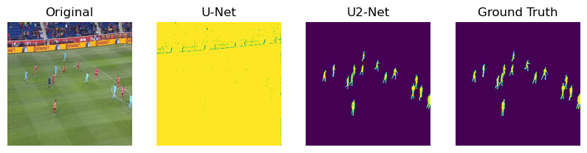

Slide 10
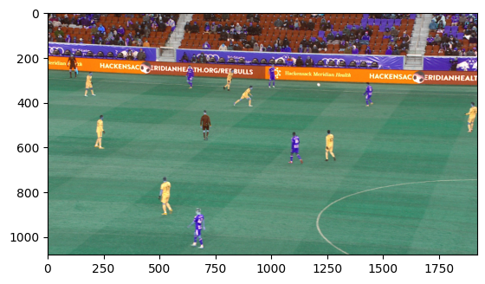
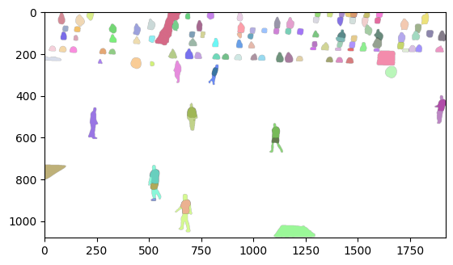
Segment Anything

Slide 11
Timeline
Inro
Project1
Project2
Project3
Project4

Slide 12
Introduction
Tracking high-speed and tiny objects is still challenging
Specifically, we track tennis ball

Slide 13
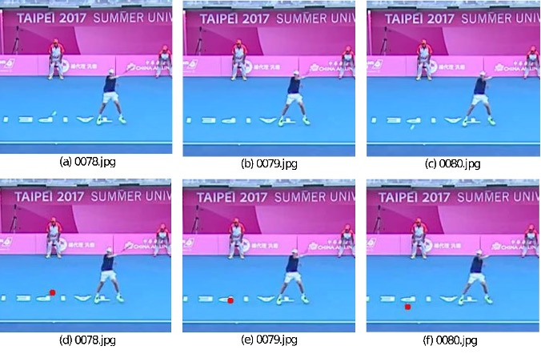
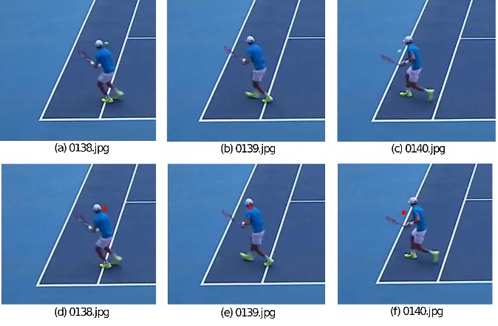
Dataset
Games
Clips/Rallies
Frames/Images, a CSV (file name, visibility, X, Y, status)

Slide 14
Model
PyTorch
U-Net shaped
Three frames in each forward path -> Ball’s trajectory
Outputs a heat map

Slide 15
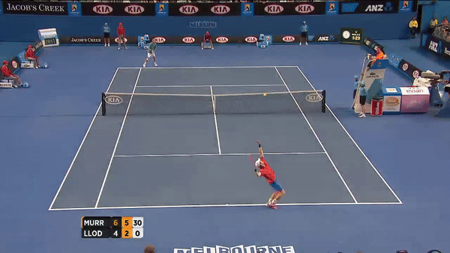
Sample Run

Slide 16
Timeline
Inro
Project1
Project2
Project3
Project4

Slide 17
Introduction
3D reconstruction

Slide 18
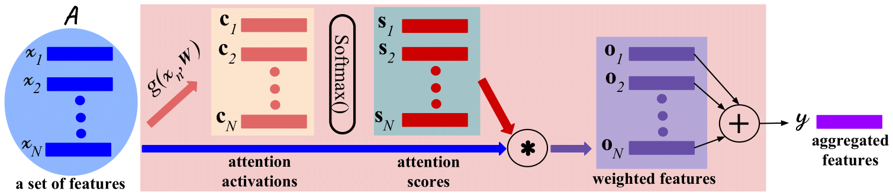
Model

Slide 19
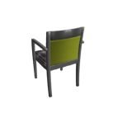

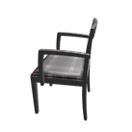
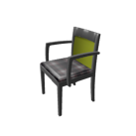
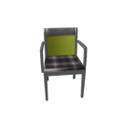
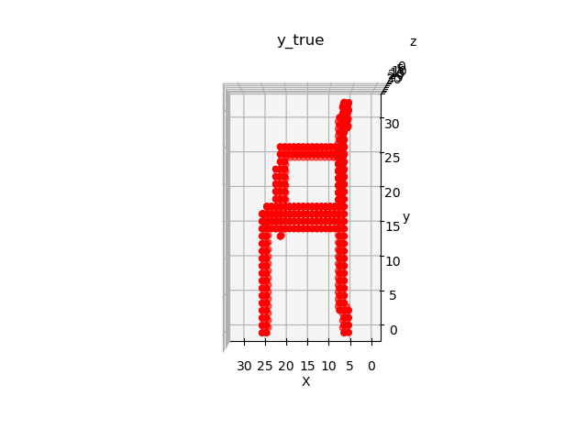
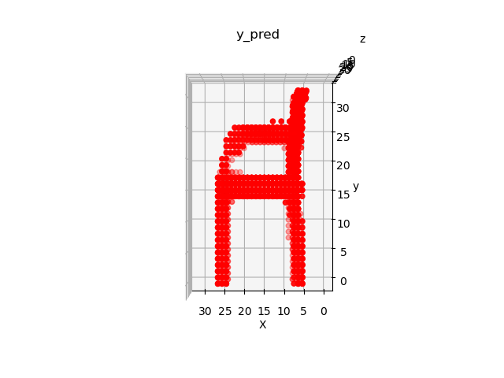
Sample Run

Slide 20
Timeline
Inro
Project1
Project2
Project3
Project4

Slide 21
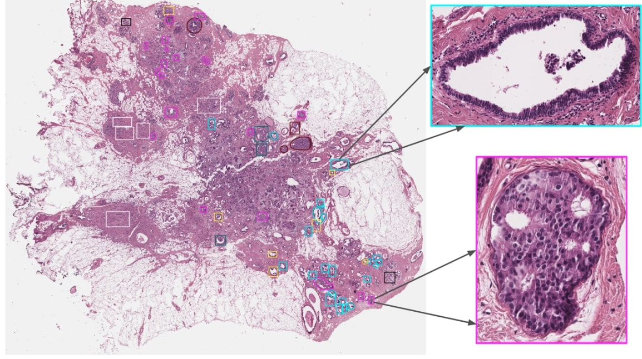
BRACS dataset
Histopathology images
Shape and colour

Slide 22
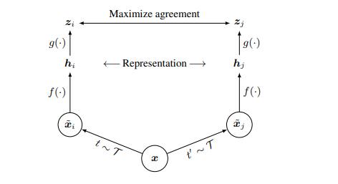
Contrastive learning
Base of project
Agreement of Representations

Slide 23
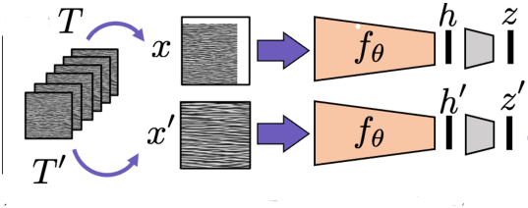
Patching
Augmentations
Backbone training
Black and white

Slide 24
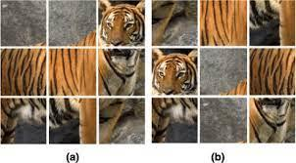
Patching
Augmentations
Backbone training
Black and white

Slide 25
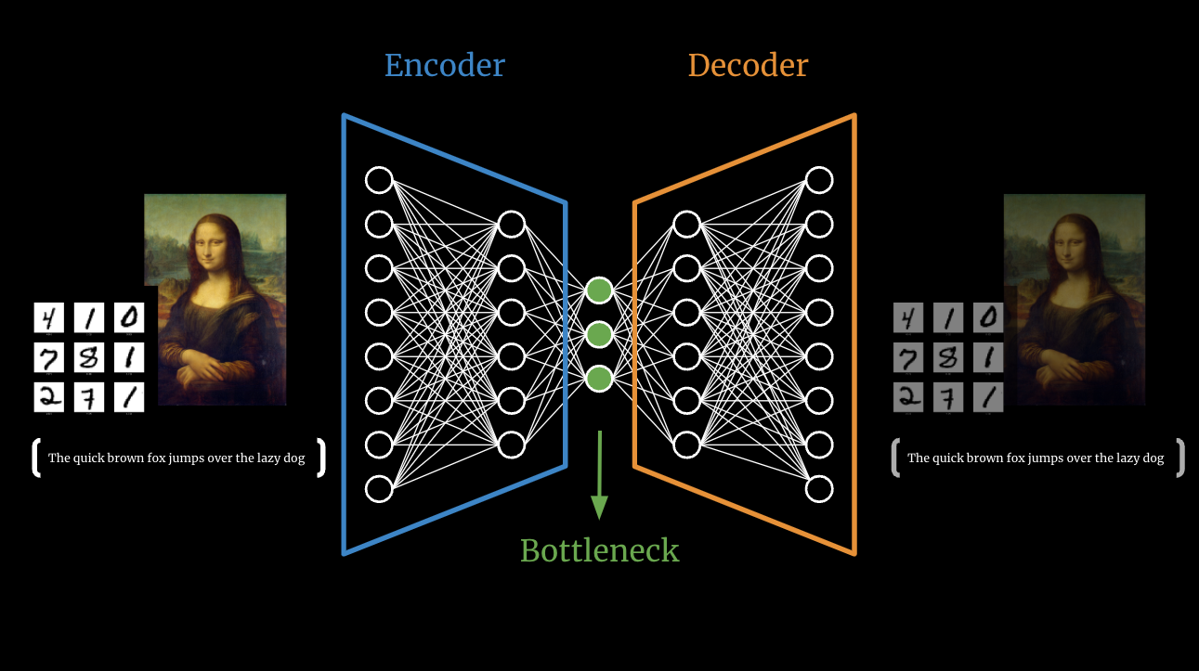
Autoencoder
Learning features
Fine tuning

Slide 26
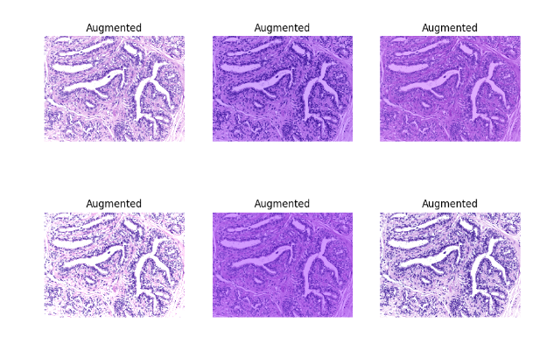
Stain normalization
Augmentations
Learning colour

Slide 27

Data problem
Computational
Need of data and time!

Slide 28
References:
https://arxiv.org/abs/2002.05709
https://arxiv.org/abs/2005.12548
https://medium.com/game-of-bits/what-are-autoencoders-in-deep-learning-ba802298bc70
https://arxiv.org/pdf/2304.02643.pdf
https://arxiv.org/abs/1907.03698
https://arxiv.org/pdf/1505.04597.pdf
https://arxiv.org/abs/1808.00758

